Slide 1
Types and Casting
Slides by Varick Erickson
© Varick Erickson

Slide 2
Objectives
Understand the basic usage for primitive types int, double, float, char
Known when and how to cast types to avoid loss of precision
Known how to convert between characters and integers

Slide 3
Primitives
Primitives are basic built-in types of the language
int (4 bytes)
char (1 byte)
bool (1 byte)
float (4 byte)
double (8 byte)
Notes:
Also have modifiers
Signed
Unsigned
Short
Long

Slide 4
What is the output?
int rise = 3; int run = 2; int slope = rise/run; cout << "Slope = " << slope << endl;

Slide 5
What is the output?
int rise = 3; int run = 2; double slope = rise/run; cout << "Slope = " << slope << endl;

Slide 6
Why are we losing precision?
int/int = int
int rise = 3; int run = 2; double slope = rise/run; 3/2 → 1 → 1.0 cout << "Slope = " << slope << endl;

Slide 7
Type Casting
Casting allow you to manually convert the type
int value; cout << static_cast<double>(value) << endl;
Other Casting Methods cout << (double) value << endl; // C-Style cast cout << double(value) << endl; // Prestandard cast
Notes:
Casts value to a double
(double) value → C-Style casting
double(value) → prestandard

Slide 8
What is the output?
int rise = 3; int run = 2; double slope = static_cast<double>(rise/run); cout << "Slope = " << slope << endl;
Notes:
Still is 1
3/2 → 1 → 1.0

Slide 9
What is the output?
int rise = 3; int run = 2; double slope = static_cast<double>(rise)/run; cout << "Slope = " << slope << endl;

Slide 10
Implicit Conversion
3/2 3.0/2 3/2.0 1.0*3/2 3/2*1.0 static_cast<double>(3)/2
Notes:
Walk through and explain each
int/int = int
double/int = double
int/double = double
double*int/int = double/int = double
int/int*double = int*double = double
3/2*1.0 = 1*1.0 = 1.0

Slide 11
char
Characters are actually integers
Each integer represents a specific character
The original set of integers was ASCII
Only represented 128 printable characters
https://en.cppreference.com/w/cpp/language/ascii
Printable ASCII (31 -
! " # $ % & ' ( ) * + , - . / 0 1 2 3 4 5 6 7 8 9 : ; < = > ?
@ A B C D E F G H I J K L M N O P Q R S T U V W X Y Z [ \ ] ^ _
` a b c d e f g h i j k l m n o p q r s t u v w x y z { | } ~

Slide 12
Unicode
ASCII too limited
Today we use Unicode (https://home.unicode.org/about-unicode/)
Unicode has 149,186 characters vs ASCII which only has 128
Allows other language characters to be used
Also defines emojis
Example: 128512 is the Unicode for 😀
Note: When you are using your IDE terminal/console, it will usually only support ASCII by default.

Slide 13
int → char char → int
32 | space |  | 64 | @ |  | 96 | `
33 | ! |  | 65 | A |  | 97 | a
34 | " |  | 66 | B |  | 98 | b
35 | # |  | 67 | C |  | 99 | c
36 | $ |  | 68 | D |  | 100 | d
37 | % |  | 69 | E |  | 101 | e
38 | & |  | 70 | F |  | 102 | f
39 | ' |  | 71 | G |  | 103 | g
40 | ( |  | 72 | H |  | 104 | h
41 | ) |  | 73 | I |  | 105 | i
42 | * |  | 74 | J |  | 106 | j
43 | + |  | 75 | K |  | 107 | k
44 | , |  | 76 | L |  | 108 | l
45 | - |  | 77 | M |  | 109 | m
46 | . |  | 78 | N |  | 110 | n
47 | / |  | 79 | O |  | 111 | o
48 | 0 |  | 80 | P |  | 112 | p
49 | 1 |  | 81 | Q |  | 113 | q
50 | 2 |  | 82 | R |  | 114 | r
51 | 3 |  | 83 | S |  | 115 | s
52 | 4 |  | 84 | T |  | 116 | t
53 | 5 |  | 85 | U |  | 117 | u
54 | 6 |  | 86 | V |  | 118 | v
55 | 7 |  | 87 | W |  | 119 | w
56 | 8 |  | 88 | X |  | 120 | x
57 | 9 |  | 89 | Y |  | 121 | y
58 | : |  | 90 | Z |  | 122 | z
59 | ; |  | 91 | [ |  | 123 | {
60 | < |  | 92 | \ |  | 124 | |
61 | = |  | 93 | ] |  | 125 | }
62 | > |  | 94 | ^ |  | 126 | ~
63 | ? |  | 95 | _ |  | 127 | delete
cout << static_cast<char>(65) << endl;
cout << 'A' + 1 << endl;
cout << static_cast<char>('A' + 1) << endl; cout << static_cast<char>(' Z ' - 1) << endl;
Notice the compiler is ok adding and subtracting integers and characters
Notes:
cout << static_cast<char>(65) << endl; A cout << 'A' + 1 << endl; 66 cout << static_cast<char>('A' + 1) << endl; B
cout << static_cast<char>('Z' - 1) << endl; Y
Note:
A char can at max store 256.
If you try to cast say 128512 to a character, it won’t work since 128512 is bigger than a character.
Need interpret as a wide character which is larger than a standard character.

Slide 14
bool
A bool value represents a true or false
Casting a bool to an integer
true → 1
false → 0
Casting an integer to a bool
The integer value 0 is false
Any other integer value that is not 0 is true
If you try to print a bool, it will print as 1 or 0 (true or false)

Slide 15
Demo/Codey sense question
int main()
{
int exam1Score;
int exam2Score;
int averageScore;
cout << "Enter your Exam 1 score: \n";
cin >> exam1Score;
cout << "Enter your Exam 2 score: \n";
cin >> exam2Score;
averageScore = (exam1Score + exam2Score) / 2;
cout << "Your average score is: " << averageScore;
cout << "\nHave a Nice Day!\n";
return 0;
}
What does this program do? Is it ok to use int type variables here?

Slide 16
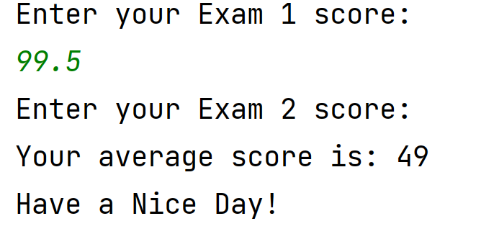
Suppose we have exam scores of 99.5 and 70
Hmm, that’s weird. I entered 99.5 and the program immediately completed. It wouldn’t let me enter the number 70 for exam 2.
What’s going on?

Slide 17
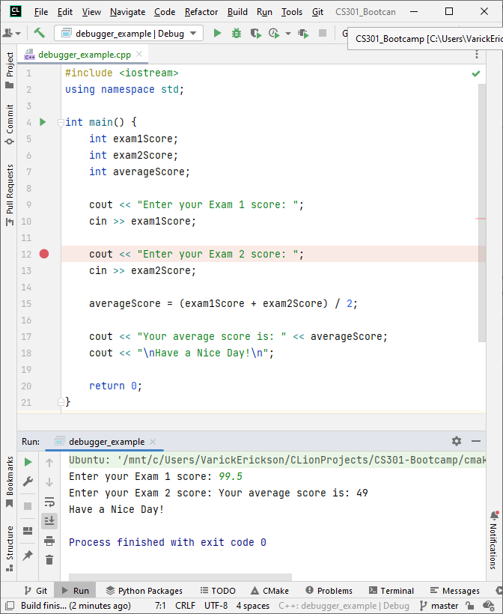
Using the debugger: Add a break point
In CLion, left click near the line numbers to add a break point (red dot) immediately on or before where you think the problem started.
This is a break point. Program will PAUSE here when we run the debugger.

Slide 18
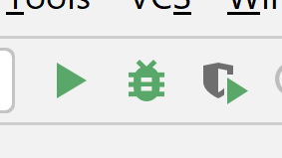
Run the debugger
After adding the break point, click the bug icon to run the debugger.
Debugger icon
This is a break point. Program will PAUSE here

Slide 19
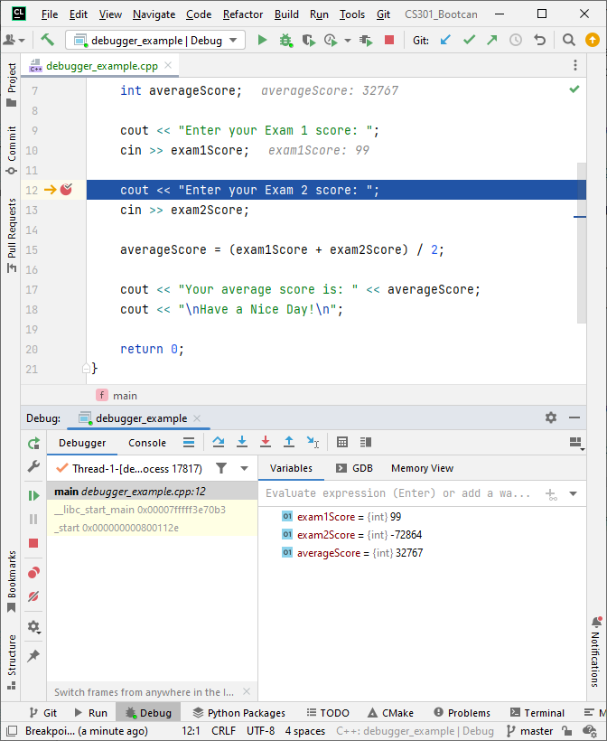
Track your variable values at the break point
The program runs as normal until break point is reached, then it pauses.
You can see the values of the variables in the bottom window
When I enter 99.5, only 99 is saved. Hmmmm…..

Slide 20
Run your code line by line
Step over button
Click “step over” or press F8 to run your code line by line

Slide 21
Key takeaways from our debugging
Variable types matter! Don’t try to squeeze a decimal into an int. You’ll lose the decimals. Rounding won’t happen. (truncation error)
Be careful what you assume about your input data. Your user may not always give whole numbers. Your answer may not always be a whole number!
Professional programmers rarely stare at code until they find an error. They step through code using a debugger until they find the source of the bug.
Learn to use the debugger! The more complex the code, the more time you will spend debugging.
Use the debugger to make sure the code is behaving as expected.

